Slide 1
Analyzing the Impact of Car Features on Price and Profitability
Project Overview: In this dataset the observation is about the best offering of cars by each manufacturers in taking consideration of better feature, good fuel efficiency , better pricing offering in the market and also how all cars features affect the pricing of the cars which are offered by each manufactures.
There several questions asked by the author with respect to feature of cars and how they effect in their pricings, So I put all questions separately and after taking insights from dataset I concluded every single question in each slides.
Approach: My approach to handle this dataset is descriptive so I used descriptive statistics tools to analyze and visualize my finding with the help of graph , pivot table, and regression analysis. The reason behind choosing descriptive statistic was that there are multiple independent variables which affect the pricing of cars. I clean the data to make normalize for my analysis using IFERROR function for removing null values.
Tech-Stack Used: I used Microsoft Excel 2021 to analyze the dataset.
Insight: The insight of this project is that every car feature have strong contribution in pricing, let say one who want more powerful engine and luxury segment body style so he has to pay very high price that’s how manufacturers set the prices accordingly. Few Point I would like to mention like MPG is barely matter for pricing, because the MPG directly related to engine type or transmission type, heavy engine power and advanced transmission type affect more on pricing not MPG alone relate any big contribution for pricing.
Result: I depict visual representation for the possible outcome in my findings, which make ease for everyone to understand.
Hyperlink for Analysis Folder: Analysis File

Slide 2
Task 1.A
Customer give more preference towards the category of car what manufacturers offer in the market, after analyzing the dataset Fuel Flex, Crossover, Luxury, Luxury, Hatchbacks are more popular in the market among others. These categories have almost double the popularity scores other than other offering categories in the market. Please see the next slide for the stacked chart graph for detail overview of popularity.

Slide 3
Task 1.B

Slide 4
Task 2
After analyzing the dependent and independent variable here I came to conclusion that low engine power model has lesser price comparatively with high engine power. Customer are more likely to buy low engine power cars because their low market price would come in customer budget.

Slide 5
Task 3
SUMMARY OUTPUT
Regression Statistics
Multiple R | 0.667023666
R Square | 0.444920571
Adjusted R Square | 0.44473413
Standard Error | 44790.99821
Observations | 11914
ANOVA
 | df | SS | MS | F | Significance F
Regression | 4 | 1.91507E+13 | 4.78767E+12 | 2386.396793 | 0
Residual | 11909 | 2.38922E+13 | 2006233521
Total | 11913 | 4.30429E+13
 | Coefficients | Standard Error | t Stat | P-value | Lower 95% | Upper 95% | Lower 95.0% | Upper 95.0%
Intercept | -72549.45639 | 2099.588389 | -34.554133 | 2.0023E-249 | -76664.9923 | -68433.92049 | -76664.9923 | -68433.92049
highway MPG | 201.3177067 | 100.7018107 | 1.99914684 | 0.045615151 | 3.925722687 | 398.7096907 | 3.925722687 | 398.7096907
city mpg | 801.3644992 | 99.7740685 | 8.031791338 | 1.05077E-15 | 605.7910413 | 996.937957 | 605.7910413 | 996.937957
Popularity | -2.915820271 | 0.284962077 | -10.2323099 | 1.79396E-24 | -3.474392448 | -2.357248093 | -3.474392448 | -2.357248093
Engine HP | 389.212014 | 4.121955726 | 94.42411316 | 0 | 381.132308 | 397.2917199 | 381.132308 | 397.2917199
After above regression analysis we can easily identified that highway MPG and Engine HP have strong linear relationship with the price of car because the significance value is less than 0.05 in both variables.

Slide 6
Task 4.A
Car Manufacture | Average of MSRP
Acura | 34887.5873
Alfa Romeo | 61600
Aston Martin | 197910.3763
Audi | 53452.1128
Bentley | 247169.3243
BMW | 61546.76347
Bugatti | 1757223.667
Buick | 28206.61224
Cadillac | 56231.31738
Chevrolet | 28350.38557
Chrysler | 26722.96257
Dodge | 22390.05911
Ferrari | 238218.8406
FIAT | 22670.24194
Ford | 27399.26674
Genesis | 46616.66667
GMC | 30493.29903
Honda | 26674.34076
HUMMER | 36464.41176
Hyundai | 24597.0363
Infiniti | 42394.21212
Kia | 25310.17316
Lamborghini | 331567.3077
Land Rover | 67823.21678
Lexus | 47549.06931
Lincoln | 42839.82927
Lotus | 69188.27586
Maserati | 114207.7069
Maybach | 546221.875
Mazda | 20039.38298
McLaren | 239805
Mercedes-Benz | 71476.22946
Mitsubishi | 21240.53521
Nissan | 28583.4319
Oldsmobile | 11542.54
Plymouth | 3122.902439
Pontiac | 19321.54839
Porsche | 101622.3971
Rolls-Royce | 351130.6452
Saab | 27413.5045
Scion | 19932.5
Spyker | 213323.3333
Subaru | 24827.50391
Suzuki | 17907.20798
Tesla | 85255.55556
Toyota | 29030.01609
Volkswagen | 28102.38072
Volvo | 28541.16014
Grand Total | 40594.73703

Slide 7
Task 4.B
Average price of cars are varying across the manufacturers in the market. The price of luxury segments are very high comparatively other manufacturer who manufacture mid level and low level segments cars. As clearly shown in graph Bugati, Machbech,Rolls royes lamborgini etc are luxury segment cars so their price are very high comparatively others cars manufacturers.

Slide 8
Task 5.A
There is negative relationship in No of cylinders in car and its highway mileage, No of cylinders does not play major role in the car market in any segments of cars. Lets say 2 cylinder car gives more mileage but their numbers are less in the market those who have 4 or 6 cylinders are more available in the market but their mileage is low comparatively.

Slide 9
Correlation Coefficient
 | Engine Cylinders | highway MPG
Engine Cylinders | 1
highway MPG | -0.614541417 | 1
Task 5.B
This shows negative relation between highway MPG and Engine Cylinders of Car as correlation coefficient is -0.61454 which is closely near to -1 that stands for strongly negative relationship and in scatter plot also the slope is downward which indicate the same i.e negative relationship.

Slide 10
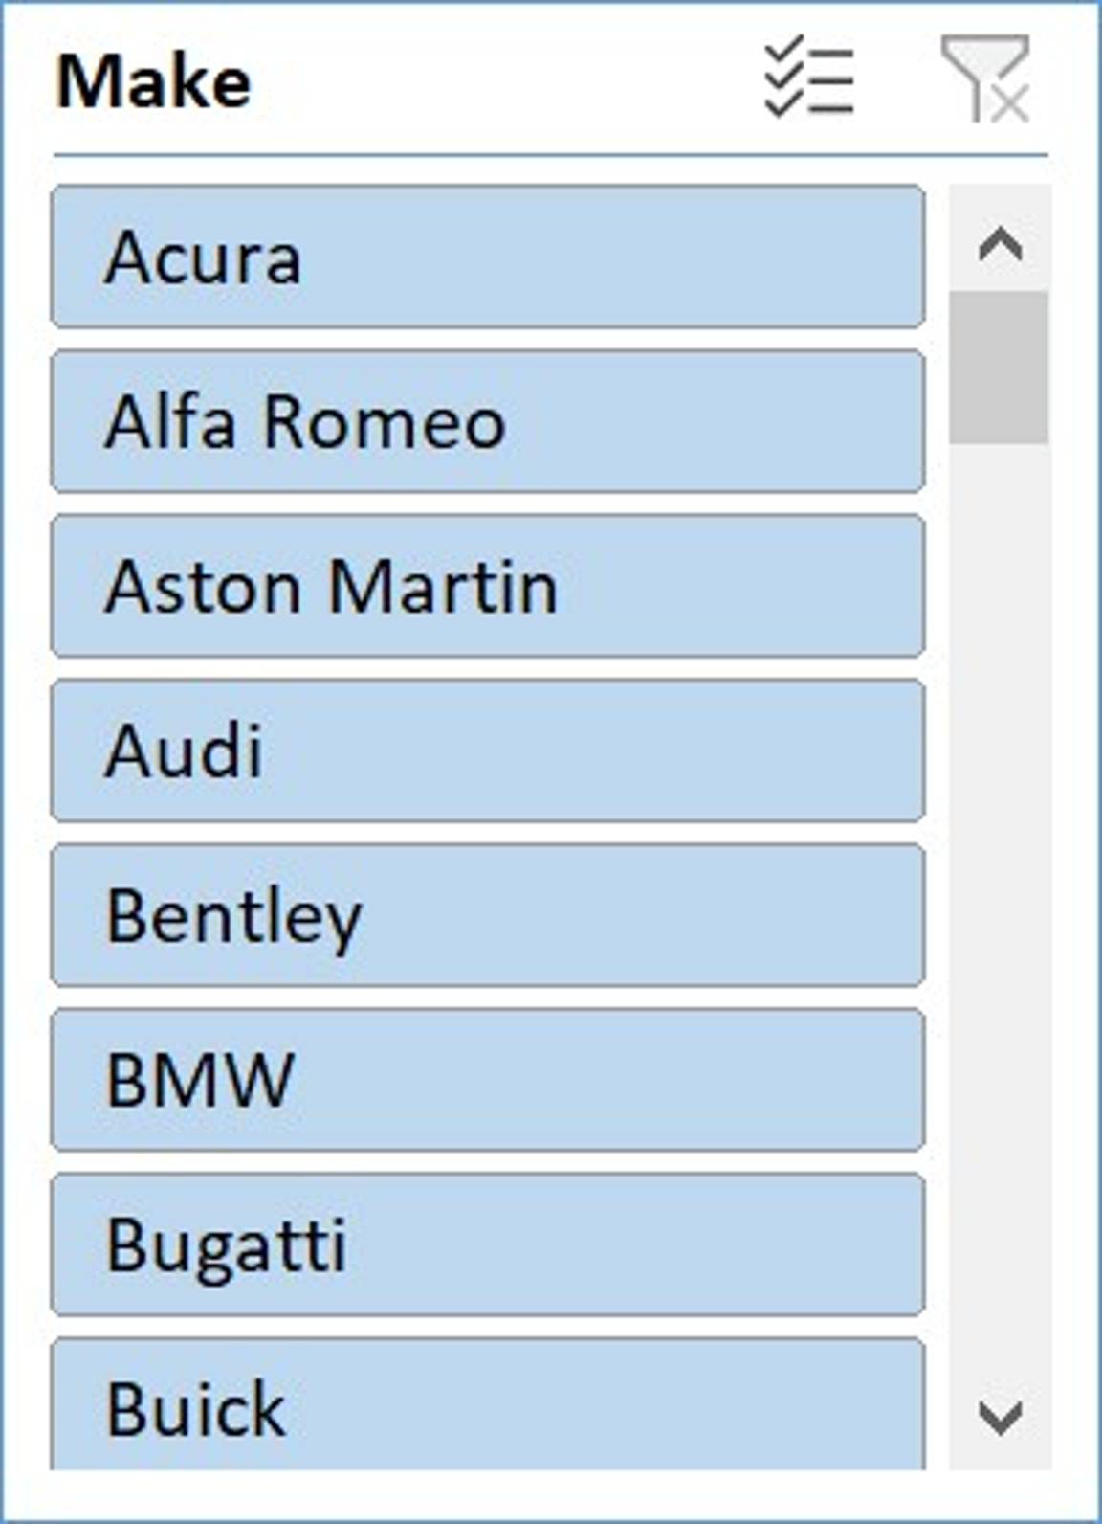
Second part- Task.1
Distribution of car price varying with the body style of car as in above graph 4 door SUV,Convertible,Coupe,Sedan have higher prices among all others body style cars. The prices are not uniform, there 4 segments are act as outliers in this dataset if we compare the body style cars they all have almost quiet uniform prices.

Slide 11
Second part- Task.2
Convertible cars have highest avg price among all other segments and 2 door SUV have the lowest avg price among all others. So body style does matter for setting prices of the cars for the manufactuers.

Slide 12
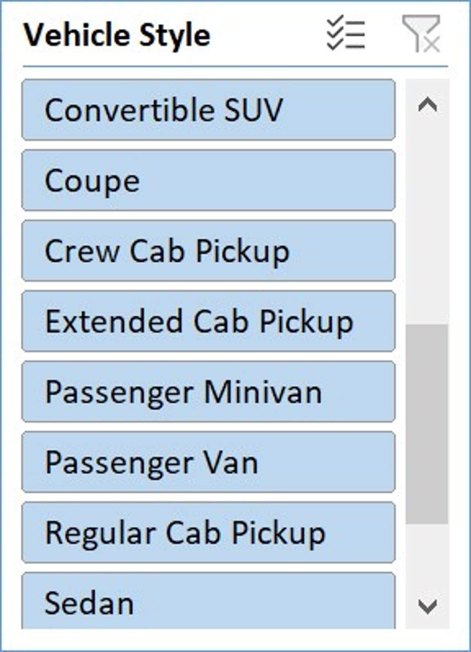
Second part- Task.3
The prices of cars vary with the transmission type and body style,automatic transmission type have come more prices in body style like covertibe and coupe and other luxury cars. And manual transmission cars comes in lower price segment.

Slide 13
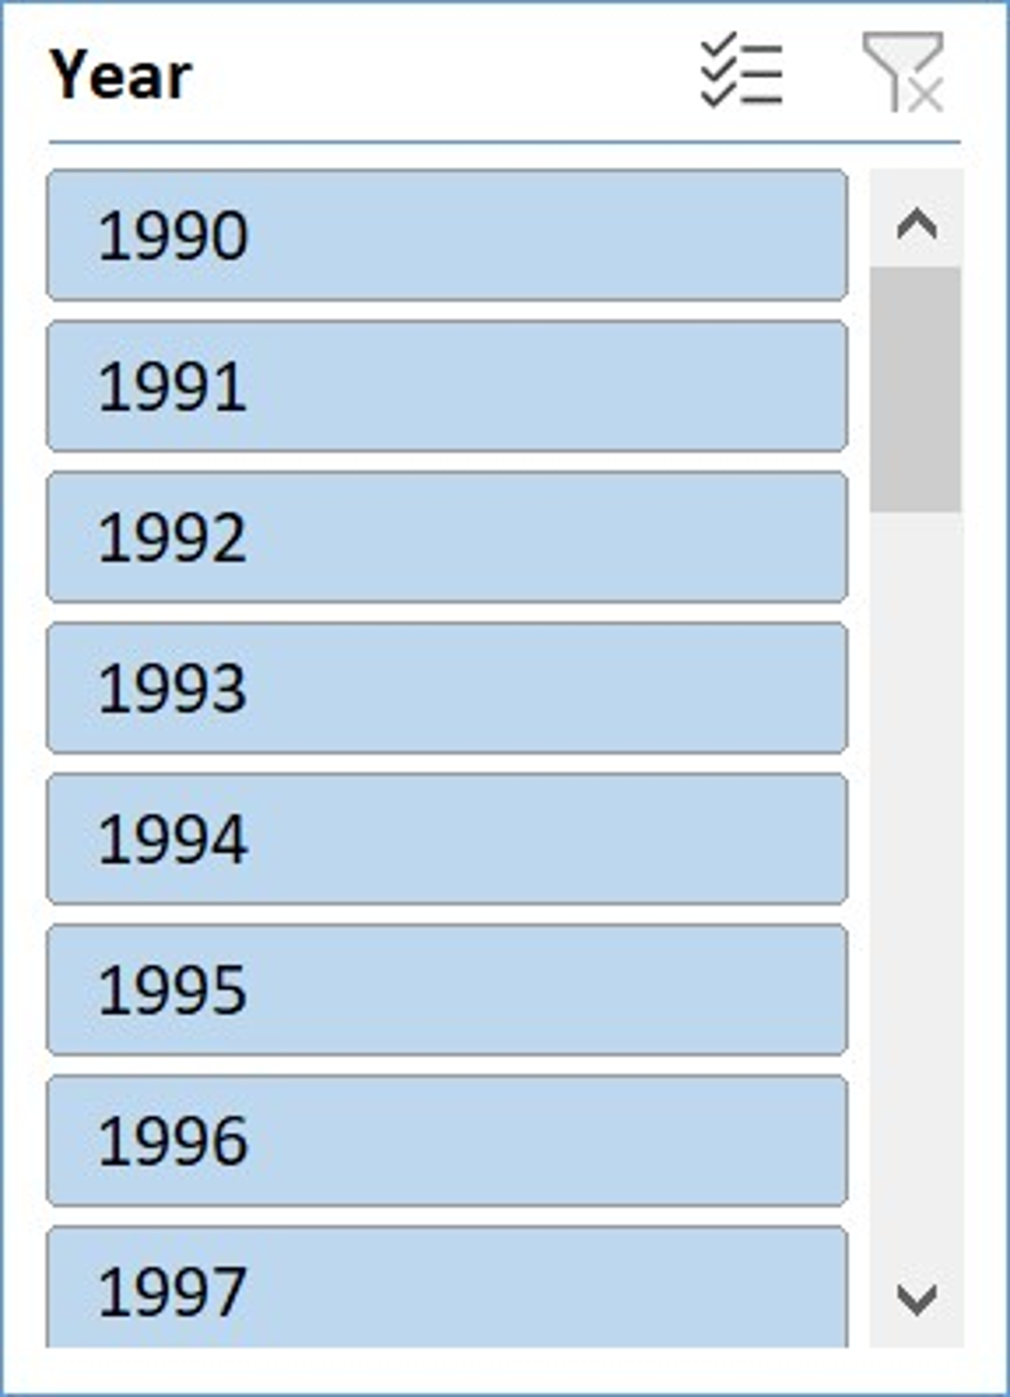
Second part- Task.4
Over the years every car model have uniformity in their fuel efficiency like 2dr hatchback,2dr suv,convertible suv,sedan and wagon give almost same fuel efficiency over the period of 1990 to 2010 but after 2010 the fuel efficiency decreases drastically till 2017 all models have lower fuel efficiency who was more fuel efficient before 2010.

Slide 14
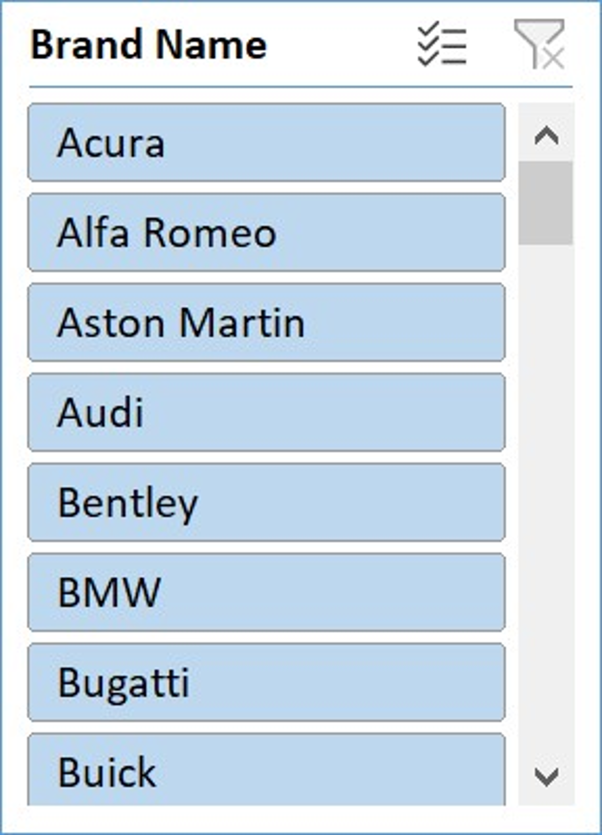
Second part- Task.5
Car prices are vary with the HP and MSRP across brands, the lower HP cars have good MPG and they come up with lower prices in the market while the high HP cars have low fuel efficiency and they are comes with higher price range in the market.

Slide 15
The End. Thankyou.

